Slide 1
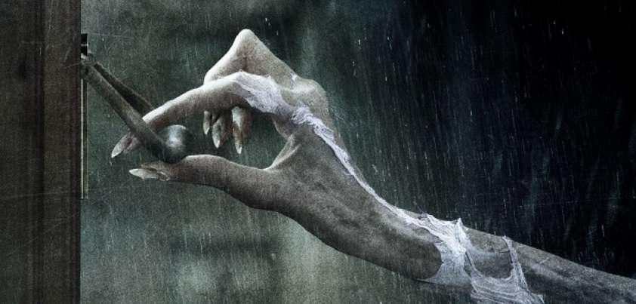
TEAM
NOCK NOCK
Nathan Davids
Okuhle Charlieman
Cole Hanekom
Kiran Isaacs

Slide 2
IMAGES
Modified website
Javascript standards
HTML -> CSS -> Javascript

Slide 3
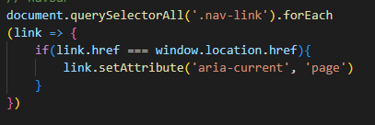

NAVIGATION BAR

Slide 4
VALIDATION
IMPLEMENTED ON:
CHECK EXAMPLES:
BOOK IT PAGE
CONTACT US PAGE
REGISTRATION PAGE
DONATION PAGE
TEXT
NUMBERS
EMAIL
PHONE NUMBER

Slide 5
EMAIL
REASON
INFORMATION
Collect User Information
Carry Out Required
PAGE FORMS
Examples:
Personal Details
Contact Details
Comments

Slide 6
MZAMOMTSHA PRIMARY SCHOOL
WEBSITE

